Slide 1

Madison AI on the go
Notes:
LEAD = KRISTINE

Slide 2
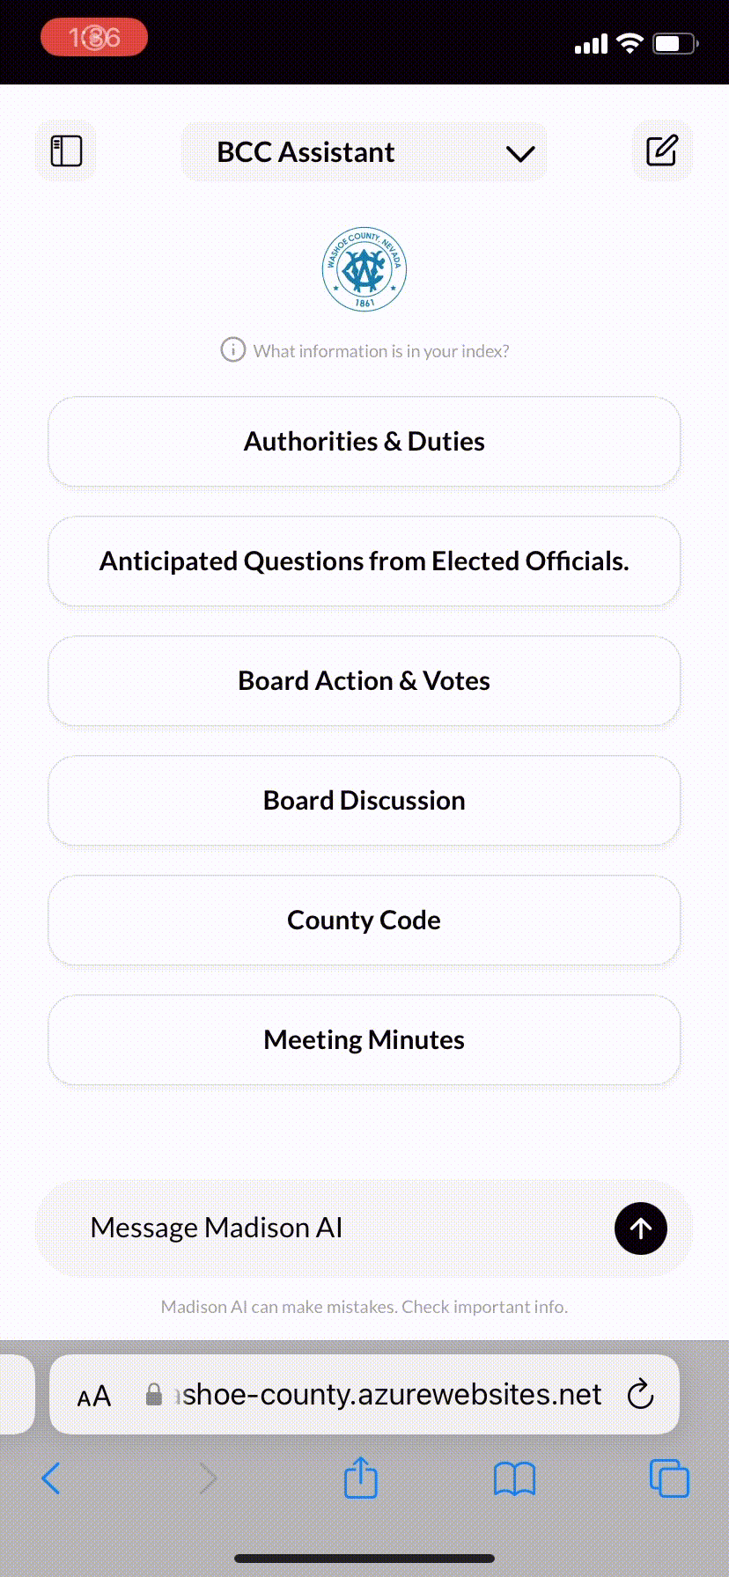

Add to iPhone/IOS Device
Step 1: Open Madison AI in Safari. Log in.
Step 2: Click the Share Button in Safari
Step 3: Click Add to Home Screen
Step 4: Follow the Prompts to Add
Step 5: Open the App on Your Phone
2
Notes:
LEAD = KRISTINE

Slide 3
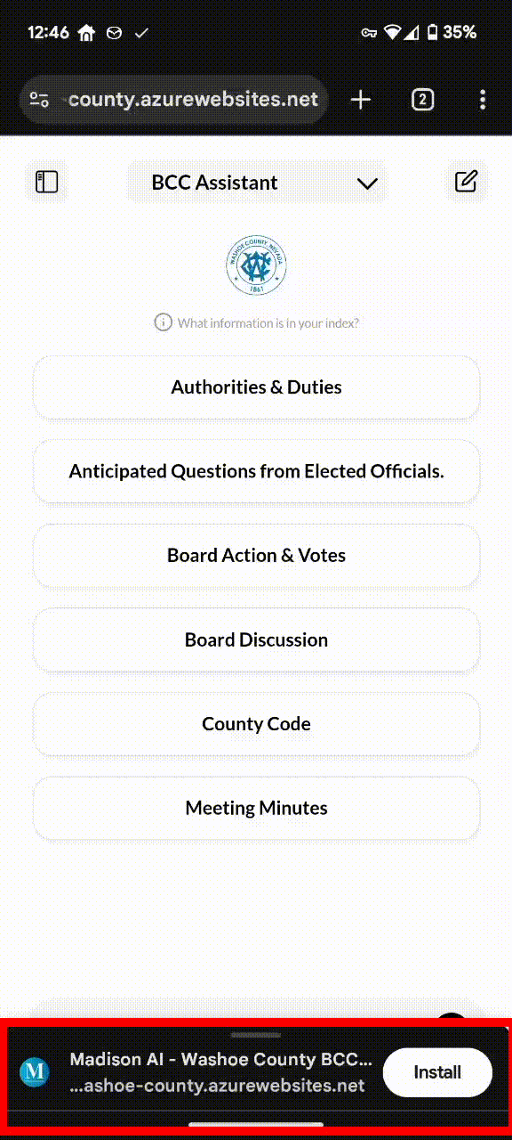
Add to Android Device
Step 1: Open Madison AI in Chrome. Log in.
Step 2: Follow the Prompt to Install the App
Step 3: Open the App on your Android Device
3
Notes:
LEAD = KRISTINE

